Slide 2
Station #1 → Oreos
STEP 1: Pick a strip from the container.
STEP 2: Take an oreo and make the correct moon phase. Use your book or notes to complete activity.
STEP 3: Each group member gets ONE cookie.
Do NOT eat the oreo until after the timer rings OR you are done with the station.
Show me cookies when complete. Walk up to me with the cookie and moon phase.
If you take more than one cookie or eat the cookie before showing me, you might receive a low grade or consequence!
STEP 4: Draw the moon phases in your notebook, using one full page.
STEP 5: Discuss your drawings and cookies.

Slide 3
Station #2 → Whiteboard
Each person needs to draw at least one planet on the whiteboard. You must include the following information for each planet
___ planet from sun
Distance from sun:
Surface gravity:
Rotation:
Revolution:
Diameter:
Temperature:
Facts:
Use your notebook and/or chapter 21 from the textbook to help you!

Slide 4
Station #3 → Smart board
STEP 1: Draw the differences between the Copernicus and Ptolemaic theories. Feel free to use the textbook or notes to help you.
STEP 2: Under each picture, write the facts about Copernicus and Ptolemy.
STEP 3: Discuss and copy any missing information in your notebook.
STEP 4: If finished early, redo and switch drawing/writing roles. Draw and write your findings in the next available page of your notebook.
ALL GROUP MEMBERS MUST DRAW OR WRITE AN EQUAL AMOUNT.

Slide 5
Station #4 → Drawing zoom in zoom out activity
STEP #1: Watch https://www.youtube.com/watch?v=jfSNxVqprvM
STEP #2: Use the black paper and white pencils to draw your own version of the “zoom out” effect. How would you put the video into one picture?
If needed, feel free to rewatch.
STEP #3: Each person should glue the black paper into the next available page of their composition notebook.

Slide 6
Station #5 → Crossword puzzle
STEP 1: You will need your notes for this activity.
STEP 2: Use my white paper and rulers to create your own crossword puzzle using the vocabulary terms from your notes. I will count the rulers at the end of class, so please do not take them with you!
STEP 3: Give your crossword to another member of your group to solve.
STEP 4: At the 2-3 minutes left mark, glue your (incomplete or completed) crossword puzzle in the next available page of your composition notebook.

Slide 7
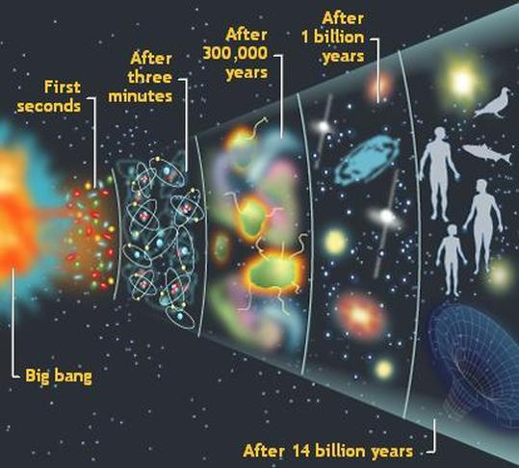
Station #6 → Big Bang
STEP 1: Look at the picture
STEP 2: Discuss what you think the big bang theory is with your group. You may use 3-5 minutes to discuss.
STEP 3: Draw your interpretation of the “big bang theory” in your notebook.

Slide 8
Station #7 → Planets guide
STEP 1: Using my stapler, staple together 5 papers like a book.
STEP 2: The top cover should be named “planets guide.” Color and decorate. WRITE YOUR NAME!!!
STEP 3: Inside your notebook, use both back and front to dedicate the next 8 pages to the planets. Use your notes to fill in ALL information (including facts and pictures!)
At the end, you should have 1 cover page and 8 pages with your planets notes. Glue in the back page into your composition book. You will now have a mini book in your composition book to refer to when needed!

Slide 9
Station #8 → Pick one or two or all!
Pick one of the following activities. If finished early, pick another until the end of the station. Glue all work into your composition notebook.
ACTIVITY #1
Story – Write a creative story about visiting one of the eight planets. What would you see?
ACTIVITY #2
Travelogue – Design a travelogue that a travel agent might use to sell a trip to the planets. Include facts about each planet and reasons for visiting there.
ACTIVITY #3
Newspaper Article – Write a “creative” newspaper article about someone who has returned from visiting a planet. Include pictures.

Slide 10
Station #9 → iPads!
You will be using the iPads at this station. There is 1 iPad per 2 group members.
App #2
Star and Planet Finder – Explore the stars and planets via the app. Draw 4 pictures in your interactive notebook of what you see on the planets app. Explain the pictures.
Rules of using MY expensive iPads
Do not drop
Do not throw
Sit when using
Turn screen off when complete
App #1
Planets – Explore the planets app. Draw 4 pictures in your interactive notebook of what you see on the planets app. Explain the pictures.

Slide 11
Station #10/#11 → Laptops (2 rotations)
STEP 1: Write these questions into your notebook. You will answer them during the video.
1. Write 3 things you knew that were confirmed in the video.
2. Write 3 things you didn't know, that you now know.
3.We look at______to learn about space.
4. Objects in outer space are close together OR far apart?
5. Because they are so far away stars appear to be very________________________.
6. The distance light travels in a year is called a(n) __________________________ .
7. Jupiter has a(n) _______________________on it that looks like a red spot.
8. According to the video, there are _______________________ planets.
STEP 2: Watch https://www.youtube.com/watch?v=So7X19JW9wY
(1 laptop per 2-3 students)

